Slide 1

Unit 10

Slide 2
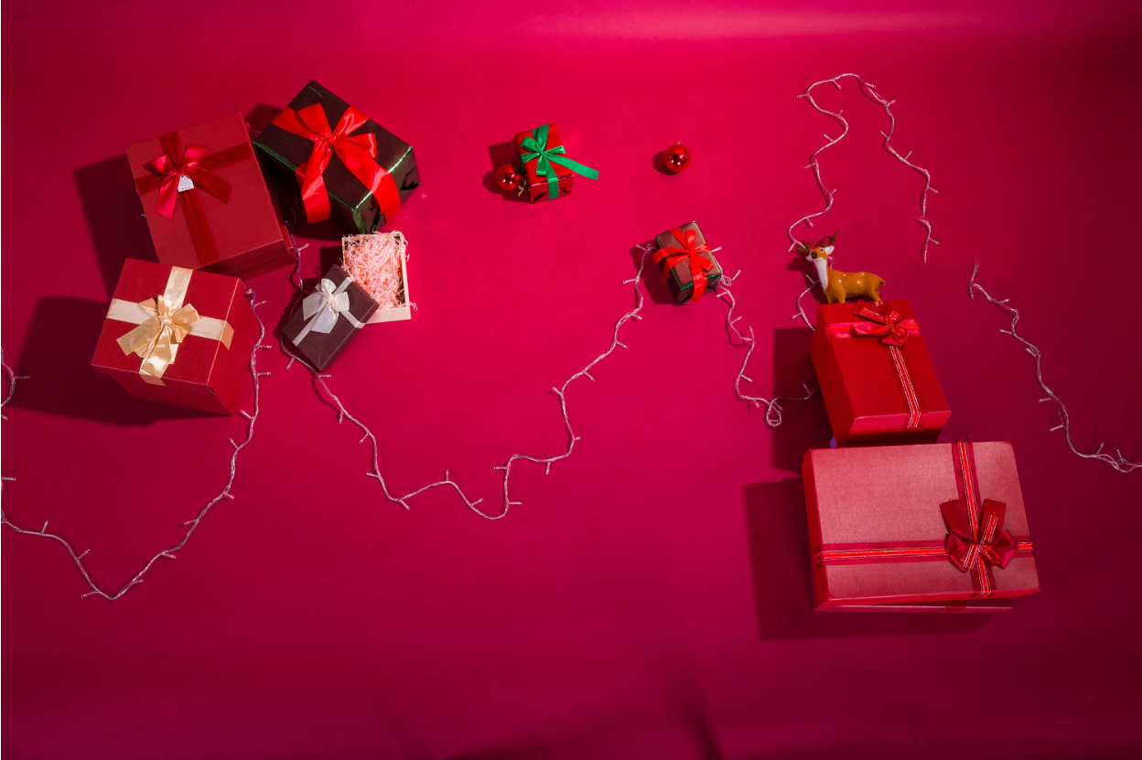
Unit 10
If you go to the party,
you’ll have a great time!

Slide 3
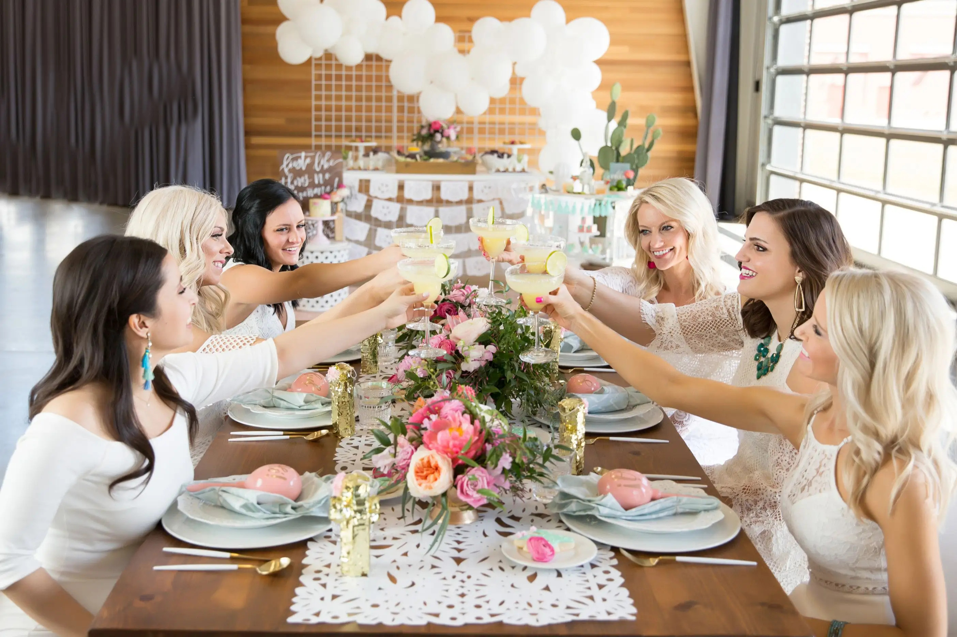
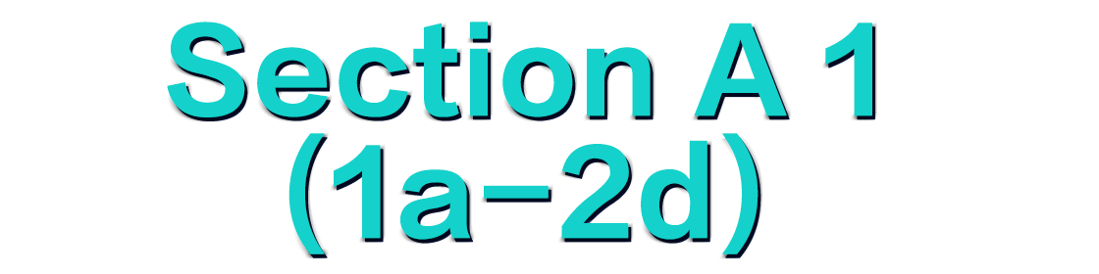

Slide 4
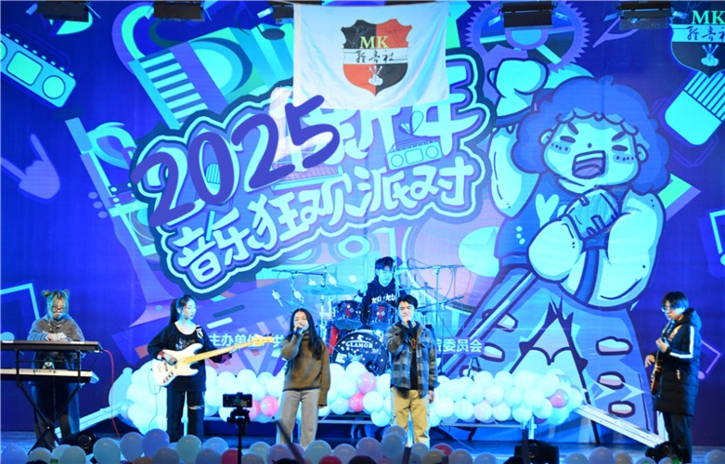
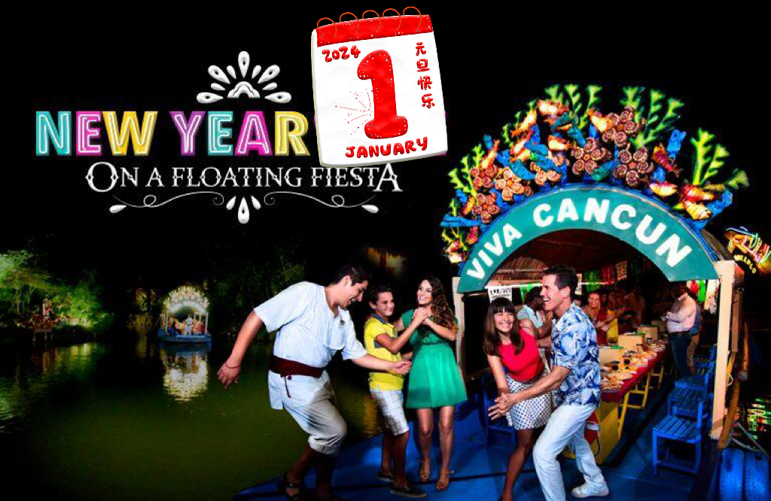
Lead-in
What festival is it?
It’s New Year’s Day.
When is it?
It’s on January 1st.
Our school will hold a New Year’s party.

Slide 5
1. A: Are you going to the party on the night of January 1st?
B: Yes, I am./ No, I’m not. I think I’ll...
A: If you do, ...will...
2. A: Who will you go with?
B: I think I’ll go with...
A: If you do, ...will...
3. A: What will you wear to the party?
B: I think I’ll wear...(a red dress/skirt/sweater/coat...)
A: If you do, ...will...
4. A: How will you go to the party?
B: I think I’ll ...
A: If you do, ...will...
Free talk

Slide 6


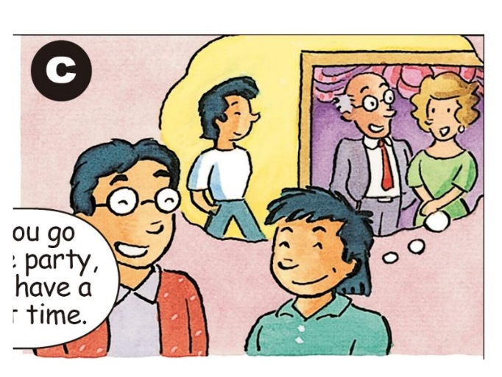
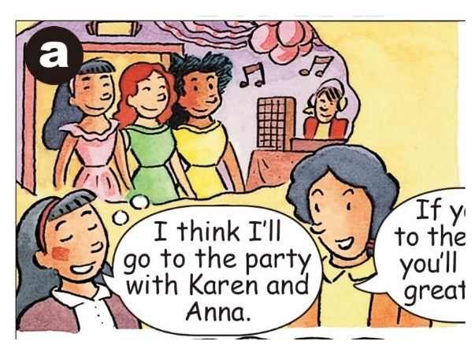
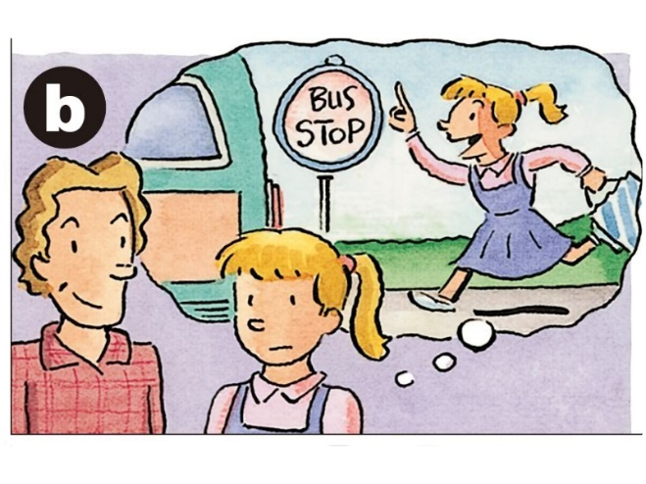
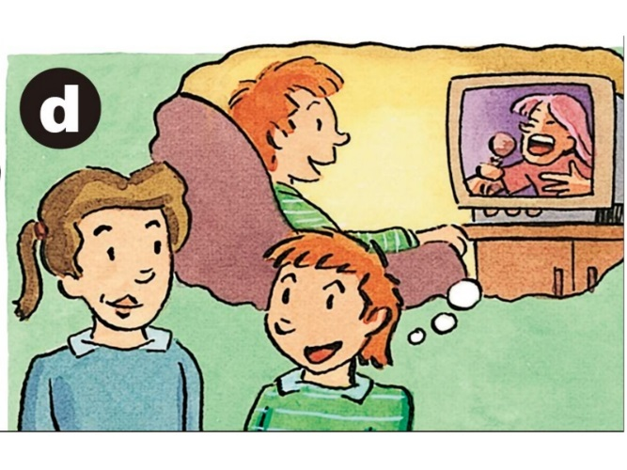
Match the statements(陈述) with the pictures [a-d].
Who will you go to the party with?
What will you wear to the party?
How will you go to the party?
Are you going to the party?
Statements
1. ___ I think I’ll wear jeans to the party.
2. ___ I think I’ll stay at home.
3. ___ I think I’ll take the bus to the party.
4. ___ I think I’ll go to the party
with Karen and Anna.
c
d
b
a

Slide 7



Listen and complete the responses(反应;回应) in 1a.
Statements | Responses
1. ___ I think I’ll wear jeans to the party. | If you do, the teachers won’t ___________.
2. ___ I think I’ll stay at home. | If you do, you’ll _________.
3. ___ I think I’ll take the bus to the party. | If you do, you’ll _________.
4. ___ I think I’ll go to the party with Karen and Anna. | If you do, you’ll _______________ .
c
let you in
d
be sorry
b
be late
a
have a great time

Slide 8
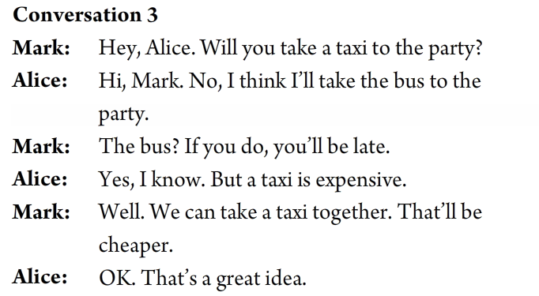
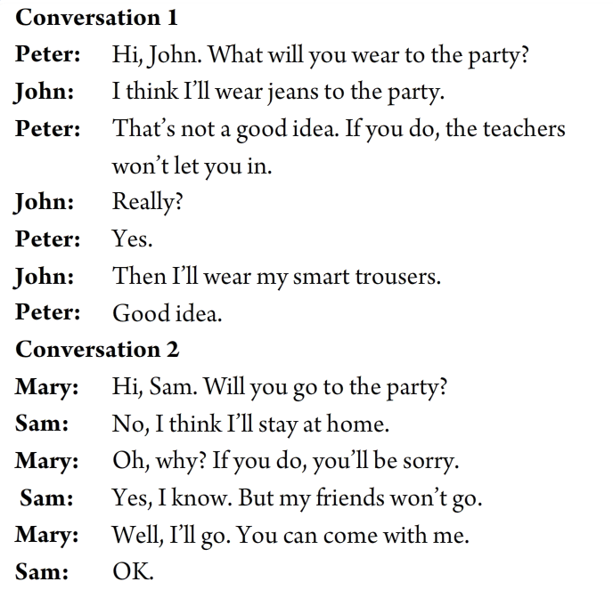
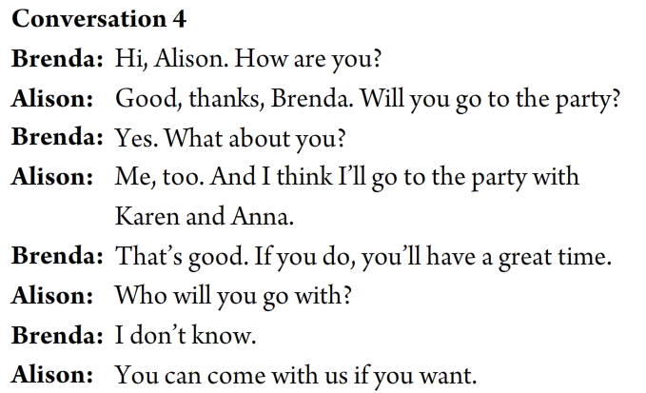
听力原文

Slide 9


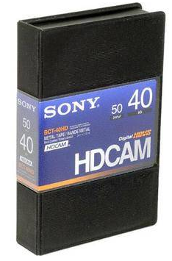
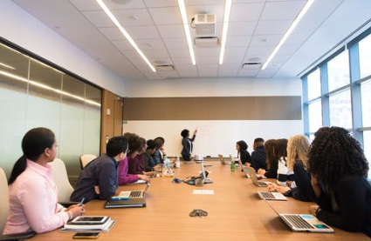
meeting n. 会议/集会/会面
video n. 录像带；录像
Is the meeting on Wednesday?
会议是在星期三吗？
Is the video on the bookshelf?
录像带在书架上吗？

Slide 10
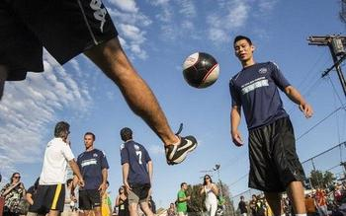
organize/organise v. 组织；筹备
Let’s organize a soccer game.
让我们组织一次足球比赛吧。

Slide 11
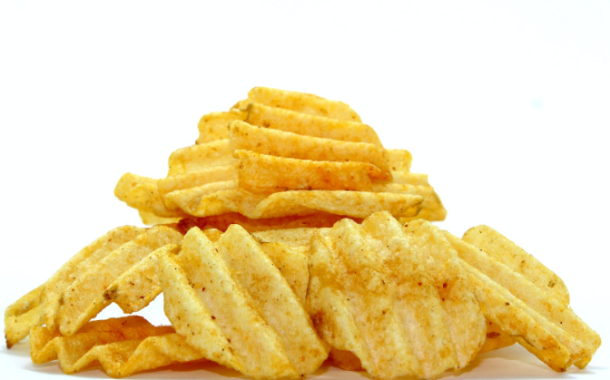
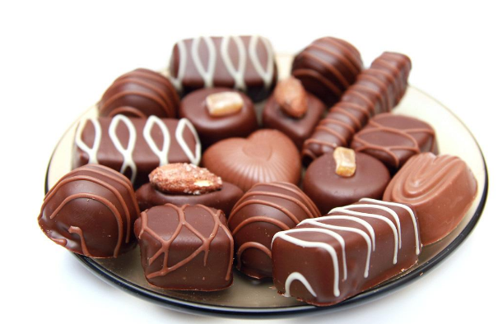
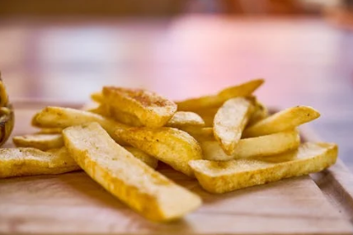
potato chips 炸土豆片；炸薯条
chocolate n. 巧克力
I’d like some potato chips, please.
我想买些薯条。
I like chocolate ice-cream best.
我最喜欢巧克力冰淇淋。

Slide 12
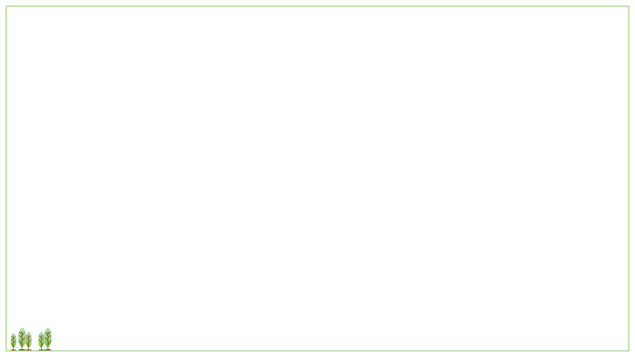


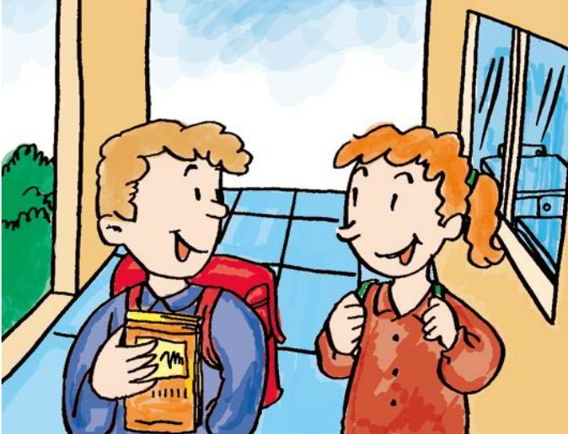
1. The students are talking about when to have (a class party/ a class meeting / a birthday party).
2. They plan to have it on (Friday evening / Saturday afternoon/ Saturday evening).
Mark Nelly
They’re maybe discussing a party/meeting and its time.
What are they discussing?

Slide 13
Listen and circle the correct answers to complete the sentences.
1. The students are talking about when to have (a class party/ a class meeting / a birthday party).
2. They plan to have it on (Friday evening /
Saturday afternoon/ Saturday evening).

Slide 14
Listen again. Choose the correct short answer in the box to answer each question.
half the class won’t come; some students will be bored; make some food; students will leave early; the party games
1. What will happen if they have the party today?
_________________________________________________
Half the class won’t come.
2. What will happen if they have the party tomorrow?
________________________________________
3. What will happen if they watch a video at the party?
________________________________________
Students will leave early.
Some students will be bored.
4. What will Mark organize?
________________________________________
5. What will Nelly do?
________________________________________
He will organize the party games.
She will make some food.

Slide 15
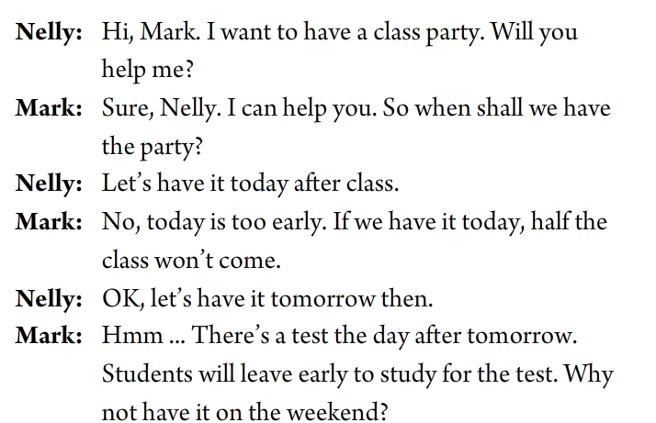
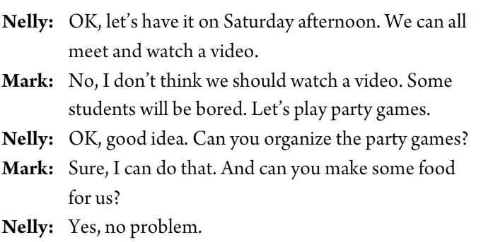
听力原文

Slide 16
Summary
主句:一般将来时
If you do, the teachers won’t let you in.
If you do, you ‘ll be sorry.
If you do, you ‘ll be late.
If you do, you ‘ll have a great time.
Half the class won’t come if they have the party today.
Students will leave early if they have the party tomorrow.
Some students will be bored if they watch a video at the party.
What will happen if they have the party today/tomorrow?
What will happen if they watch a video at the party?
从句:一般现在时
在if引导的条件状语从句中，主句用一般将来时，从句用一般现在时表示将来。 遵循主将从现原则。

Slide 17

if 引导的条件状语从句中，主句用一般将来时，从句用一般现在时表示将来。【主将从现原则】
if 引导的条件状语从句中，主句有must/can/may 等情态动词，
从句用一般现在时。
3. if 引导的条件状语从句中，主句是祈使句，从句用一般现在
时表示将来。
e.g. We will go to the park if it _______ _______ (rain) tomorrow.
doesn’t
rain
e.g. You must stop if the traffic light _____ (be) red.
is
e.g. Don’ t wait for me if I ______ (be) late.
am

Slide 19

if引导的条件状语从句
从句，一般现在时
主句，一般将来时
1. If you go there by bike, you will be late.
if 条件状语从句的主从复合句中，主句用一般将来时，从句用一般现在时表示将来。主将从现原则。
e.g. We will go to the park if it _______ _______ (rain) tomorrow.
doesn’t
rain

Slide 20
从句，一般现在时
主句，情态动词
2. If you are ill, you must go to the doctor.
if 条件状语从句中，如果主句有must，can，may 等情态动词，从句用一般现在时。
e.g. You must stop if the traffic light _____ (be) red.
is
主句，祈使句
从句，一般现在时
3. Please call me if you come back.
if 条件状语从句中，主句是祈使句，从句用一般现在时表示将来。主祈从现原则。
e.g. Don’ t wait for me if I ______ (be) late.
am

Slide 21


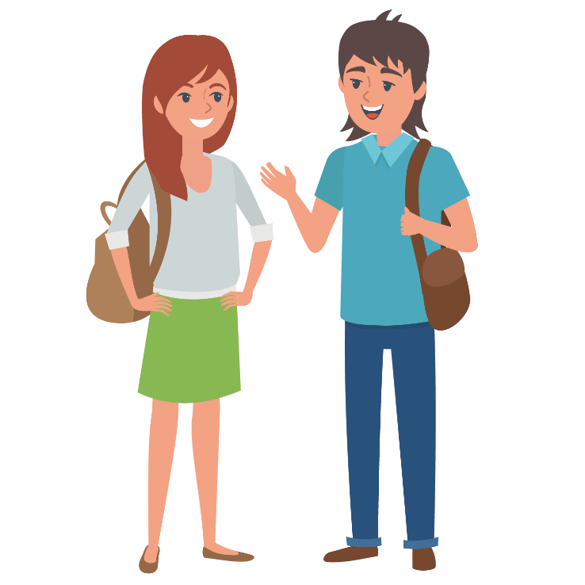
Look at the pictures and make conversations.
Are you going to the party tomorrow night?
Yes, I am.
Who will you go with?
I think I’ll go with Karen and Anna.
If you do, you’ll have a great time.

Slide 22

句子接龙
Make the sentences one by one.
If I go to the party, I will…
If …
If I go to the party, I will come back home late.
If I come back home late, I won’t finish my homework.
If I don’t finish my homework, I will… /my teacher will…/my parents will…
If I/my teacher/my parents…

Slide 23



Role-play a conversation between Nelly and Mark.
OK, when is a good time to have the party?
Let’s have it today.
Hmm. If we have it today, half the class won’t come.
Why not have it on the weekend?
OK, good idea.

Slide 24
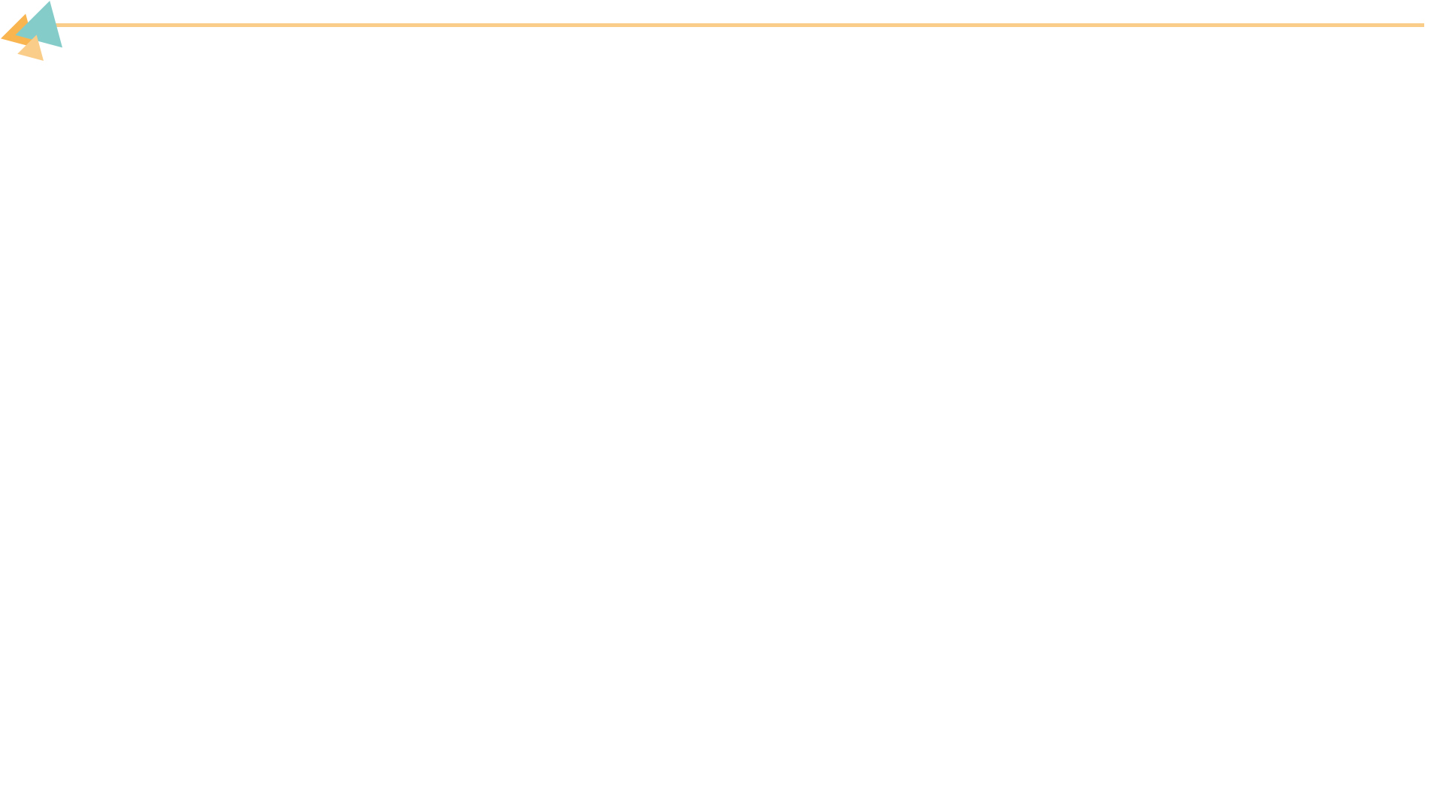

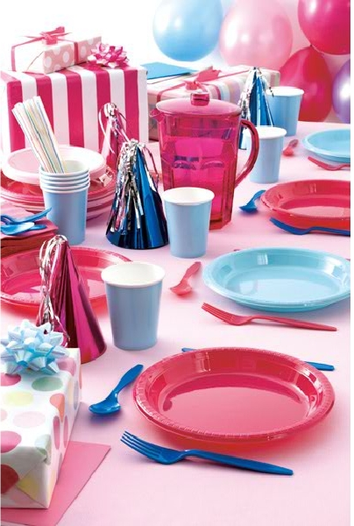
If you are going to hold a party, how will you prepare for it?
Place | Food | Activities | others

Slide 25


Listen to the conversation and answer the question.
What does Jeff need to prepare for the party?
They are talking about food and games for the party next week.

Slide 26
Read the conversation and answer the questions.
1. What will happen if they ask people to bring food?
2. What will happen if they give people some small gifts if they win?
They’ll just bring potato chips and chocolate because they’ll be too lazy to cook.
More people will want to play the games.

Slide 27
Fill in the blanks.
Ben and Jeff are planning for the party next week. They won’t ask people to bring food. If they ask people ________ (bring) food, they ________ (bring) potato chips and chocolate because they ________ too lazy to cook. So they will ________ (order) food from a restaurant. For the games, Jeff thinks that they should give people some small gifts ________ they win. If they do that, ________ (many) people ________ (want) to play the games and the games will be more ________ (excite).
to bring
will bring
will be
order
if
more
will want
exciting

Slide 28
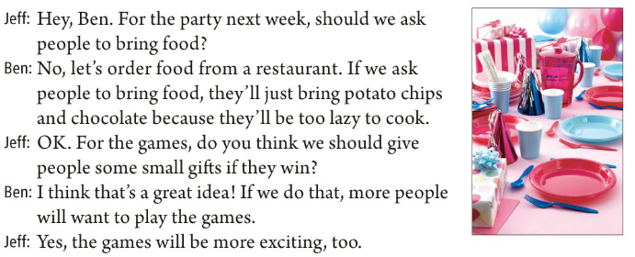
Listen to the conversation.
if 引导的条件状语从句

Slide 29



You will hold a party next Sunday. Where will you have the party? What should you prepare for it?
Make a conversation with your partner.

Slide 30

Role-play the conversation.
Hey, ... For the party next Sunday, should we ask people to …?
No, …
…

Slide 31



Yes, the games will be more ________ (excite), too.
对，（那样的话）游戏也会更加有趣。
exciting adj. 令人兴奋的、令人激动的
e.g. The movie has an exciting opening.
exciting
exciting adj. 令人感到兴奋的，常修饰物/事件；
excited adj. 对……感到兴奋，常修饰是人。
e.g. Are you excited about going to Beijing?
He told us an exciting story yesterday.
exciting
&
excited

Slide 32
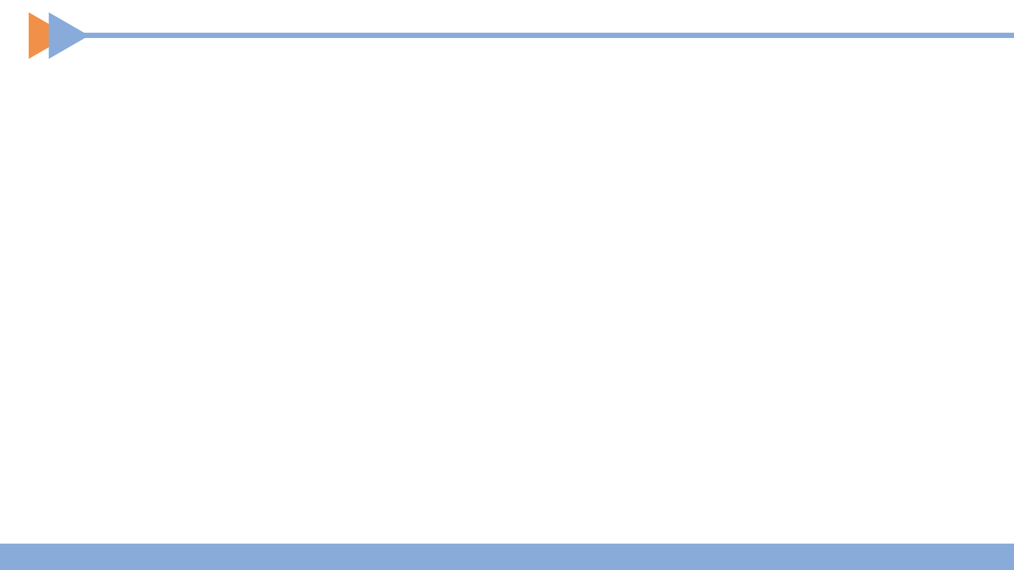

去参加聚会
玩得开心
订餐
看录像
待在家
一半的学生
班会
炸土豆片；炸薯条
叫某人做某事
go to the party
have a great time
order food
watch a video
stay at home
half the class
class meeting
potato chips
ask sb. to do sth.

Slide 33
I think I’ll take the bus to the party.
If you do, you’ll be late.
What will happen if they have the party tomorrow?
When is a good time to have the party?

Slide 34
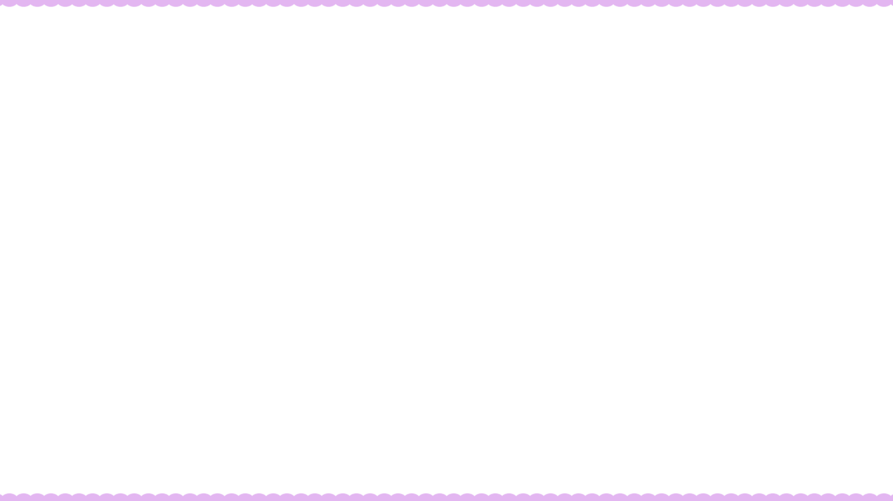

Ⅰ. 根据语境及所给首字母提示，补全所缺单词。
1. We will have a m to discuss these problems.
2. —I’d like to eat a piece of milk c . What about you?
— No, thanks. I think it’s too sweet (甜的).
3. Jenny o that party. She asked her friends to come and bought some food and drinks.
4. Let’s go to Helen’s home tonight and watch the v of her wedding (婚礼).
meeting
chocolate
organized
video

Slide 35
Ⅱ. 根据句意及所给汉语提示，写出所缺内容，每空一词。
1. They had _______ _______(炸薯条), drinks and cakes at the party.
2. _______ _______ _______(一半的学生) did well in the spelling test yesterday.
3. We can’t _______ _______(穿牛仔裤) at work.
4. Now many people like to _______ _______(订餐) online. It can save a lot of time.
5. You’re never _______ _______ _______ _______(太老而不能学习).
potato chips
Half the class
wear jeans
order food
too old to learn

Slide 36
Ⅲ. 根据对话内容，从方框中选择恰当的选项补全对话，其中有两
项多余。
A: We had a great time at Nick’s home the day before yesterday. (1)_______
B: I didn’t feel well.
A: (2)_______
B: I had the flu and stayed in bed all day. I didn’t go to school
yesterday.
A. How do you like it? B. Why didn’t you come?
C. Did you go to the doctor? D. I believe you can make it.
E. What was wrong with you (你哪儿不舒服)?
F. If you don’t go to the doctor, you will get worse.
G. Let me know if you have any questions about those test papers.
B
E

Slide 37
A. How do you like it? B. Why didn’t you come?
C. Did you go to the doctor? D. I believe you can make it.
E. What was wrong with you (你哪儿不舒服)?
F. If you don’t go to the doctor, you will get worse.
G. Let me know if you have any questions about those test papers.
A: That is too bad. (3)_______
B: No. I think I’ll be all right after staying in bed for a day.
A: Oh, no. (4)_______
B: Maybe you’re right. I will see the doctor this afternoon. Did you learn anything new yesterday?
A: No. We only took some tests. Don’t worry. (5)_______
B: Really? That’s very kind of you. Thank you.
A: No problem.
C
F
G

Slide 38


Write down your plans about your birthday party.
Preview Grammar Focus.

Slide 39


Slide 40



To be able to get specific information about a party.
To learn to talk about consequences.
— I think I’ll go to the party.
— If you do, you’ll have a great time.
— What will happen if they have the party today?
— If they have it today, half the class won’t come.

Slide 41


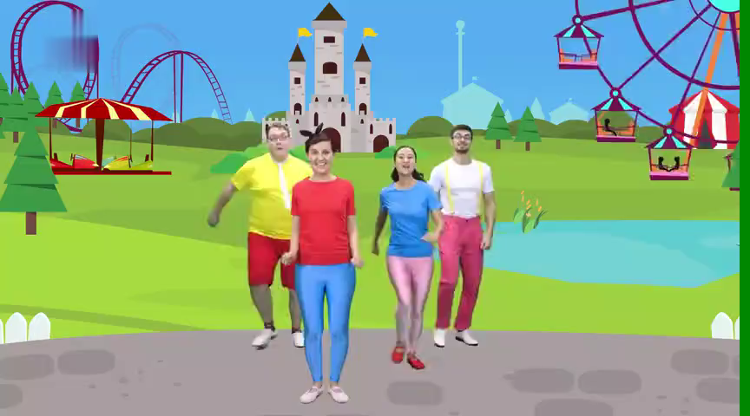
If you’re happy, what will you do?
If I’m happy, I will…

Slide 42
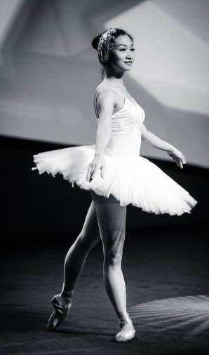
What will happen if you wear a ballet skirt to the party?
I will…
my friends will…
my parents will…
…
If I wear a ballet skirt to the party，

Slide 43

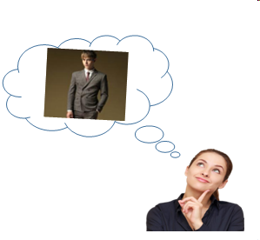
I’d love to go to my brother’s 18th birthday party. What will happen if I give him a new suit?
If I …, my brother will…

Slide 44
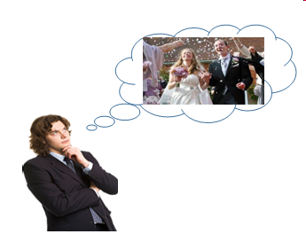
I look forward to attending my aunt’s wedding. What will happen if I sing the song — all good things come to an end?
If I …, my aunt will…

